Slide 1
Part 1:
Introduction to machine learning
Machine learning fundamentals

Slide 2
Lesson concepts
Machine learning fundamentals:
Introduction to regression and classification
Matrix operations
Linear regression
Coding our first ML models
Machine learning fundamentals

Slide 3

MACHINE LEARNING

Slide 4
Machine learning fundamentals
Linear algebra
Vector/matrix operations
Probability

Slide 5
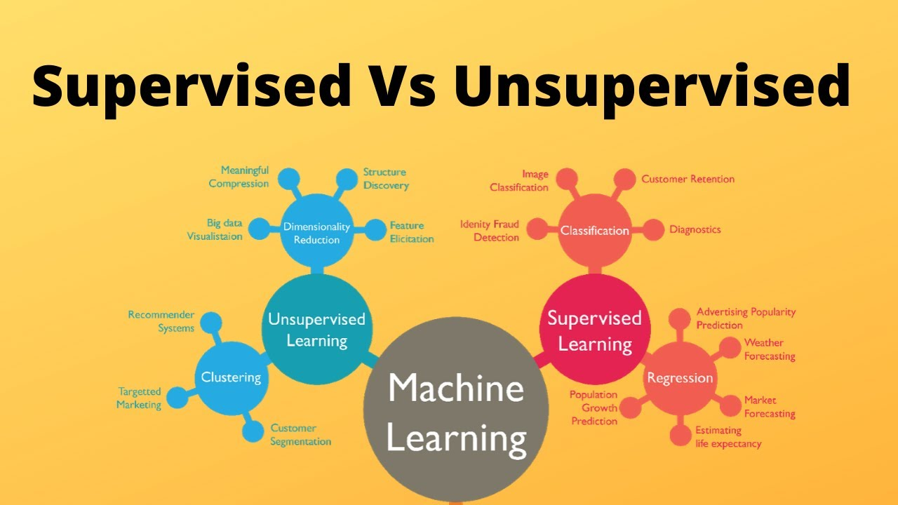
Machine learning fundamentals
Types:
Supervised learning
Unsupervised learning

Slide 6
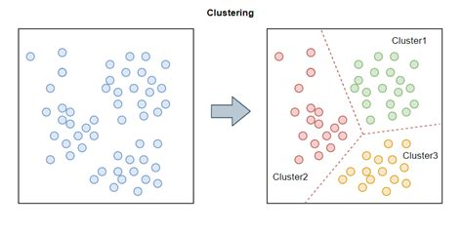
Machine learning fundamentals
Unsupervised learning
Learning with no labels - clustering by noticing similarities between variables

Slide 7
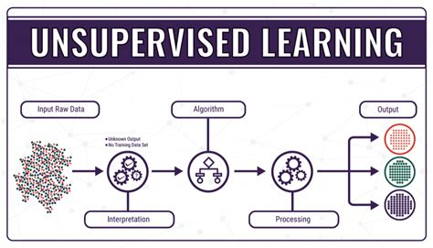
Unsupervised learning
Unsupervised learning - examples
Facebook grouping people together based on their similar demographics and seeing if they all have similar behaviours
Customer segmentation - putting similar customers into separate segments based on purchasing habits
Dimensionality reduction of data

Slide 8
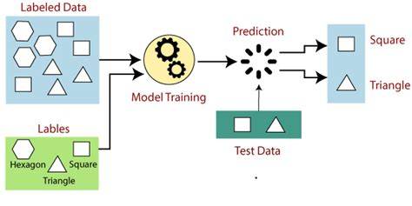
Supervised learning
Learning with a labelled dependent variable (e.g. house prices, titanic survival, number of ice cream sales)

Slide 9
Supervised learning
Supervised learning - examples
The probability of a given user clicking on an ad
The value of stock prices on a given day
House prices based on information about the house
Probability of a given person making regular loan repayments based on previous financial history

Slide 10

Supervised learning (labelled data)
Regression
Classification
Discrete Continuous

Slide 11
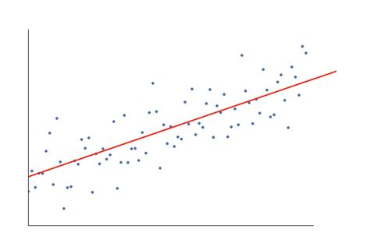
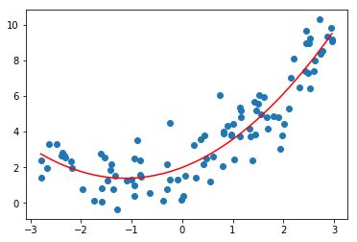
Regression
Predictions based on a continuous number
Predicted exam results based on educational background and previous results
Predicted distance travelled by a space rocket based on last known location, speed and other conditions

Slide 12
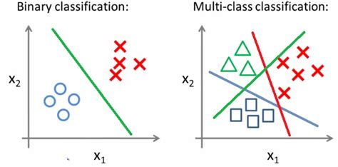
Classification
Discrete output of a limited number of classes
E.g. if there’s only two outcomes (survived, not survived or paid loan interest, not paid) this will be binary classification (0,1)
Any more than two outcomes (classes) And it is multi-class classification - e.g. self driving cars image recognition - cat, dog, traffic light, etc

Slide 13
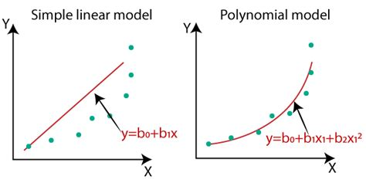
Linear relationships vs polynomial
Linear is the use of straight lines to describe the patterns in data
Polynomial is the use of non-straight lines to describe patterns in the data
This isn’t as important for today but something to take note of

Slide 14
All you need to remember for now
Supervised learning (labelled dependent variable)
Regression (continuous variable output)
Linear relationships

Slide 15
Linear algebra - linear regression
Plotting coordinates on graphs
Drawing lines of best fit (y = mx + c) - linear regression
Creating predictions from our line of best fit
Cost and loss functions

Slide 16
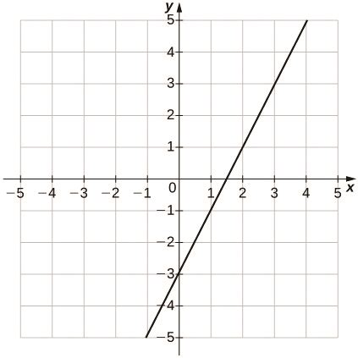
X - y graph
Dependent and independent variables
Univariate linear regression
What could this graph represent? Which one is the dependent variable?

Slide 17

Plotting coordinates (x_{i} , y_{i})
x | 1 | 2 | 3 | 4 | 5
y | 3 | 4 | 5 | 6 | 7
What is x₁?
What is y₃?
What is y when x is 5? What would i be?
What might ‘i’ mean here?
Hint: placeholder

Slide 18
Plotting coordinates
Have a go
x | 2 | 4 | 6 | 8 | 10
y | 8 | 14 | 20 | 26 | 32
Draw out the following table as a graph. Do you see a pattern in the data?
Optional:
https://www.tutorialspoint.com/whiteboard.htm

Slide 19
Line of best fit
How can we describe a line of best fit?
There are two common ways in the beginning
Linear models describe a pattern in the data with a straight (linear) line

Slide 20
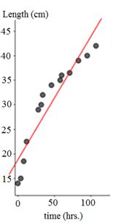
Line of best fit
“What do I need to do to my input (x) to get my output (y)?”
Y = mx + c
Expressing this visually and mathematically

Slide 21
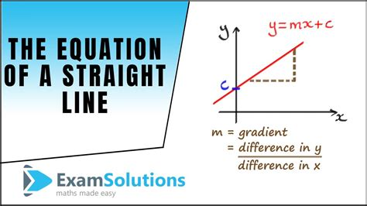
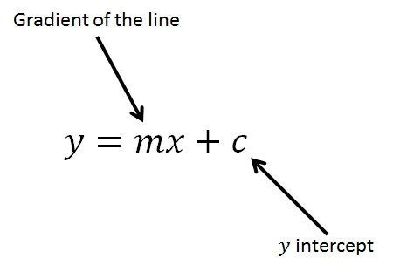
y = mx + c
m describes the gradient of the line
c describes the y-intercept

Slide 22
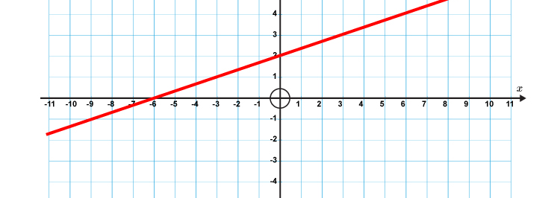
y = mx + c
Calculating c - the y-intercept

Slide 23
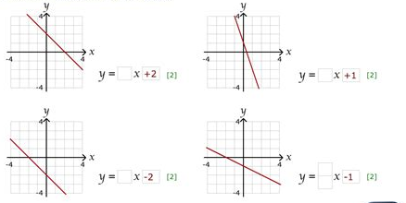
y = mx + c
m describes the gradient of the line
c describes the y-intercept
Note: m is also known as the coefficient

Slide 24
y = mx + c
Y = x + 4
Y = x - 2
Y = 3x + 1
Y = 2x
Y = 0.5x + 4
Examples

Slide 25
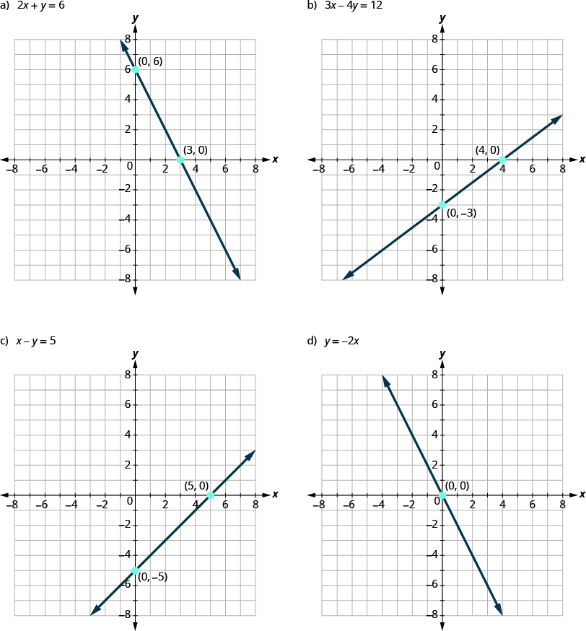
y = mx + c
Construct the equations to describe the following lines

Slide 26
y = mx + c
1)
2)
3)
x | 1 | 2 | 3 | 4 | 5
y | 4 | 5 | 6 | 7 | 8
x | 1 | 2 | 3 | 4 | 5
y | 8 | 14 | 20 | 26 | 32
x | 1 | 2 | 3 | 4 | 5
y | 1.5 | 2 | 2.5 | 3 | 3.5
From this data draw out the coordinates, describe the equation of the line

Slide 27
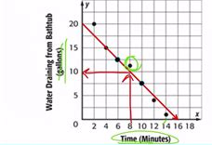

Line of best fit - predictions
Data, y=mx+c and graph to make a prediction
For any of the graphs from the previous slide,
Try to:
Make a prediction from sight
Predict from your equation
We can use either of these at this scale to make a prediction!

Slide 28
Practise
Plot this data onto a graph
Draw the line of best fit based on what looks to fit the best then write the corresponding equation and plot it for 1 hour, 2 hours, etc.
Compare the two lines
Make a prediction for the distance the a 7 hour flight would make
Length of flight (hours) | 2 | 5 | 6 | 10 | 15
Distance (miles) | 800 | 2000 | 2400 | 4000 | 6000

Slide 29
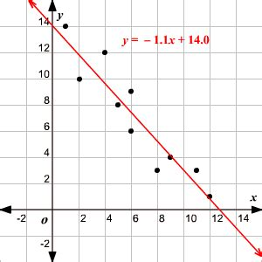
Line of best fit
Straight lines rarely ever fit all of the data points in real life. So we try to draw/define a line which fits most closely to all of our data points
Data doesn’t fit the pattern so well in real life

Slide 30
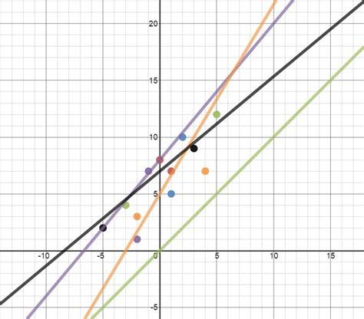
Line of best fit
When your straight lines aren’t able to touch all of the data points, how do we decide which line of best fit is the actual best one?
Optimising the line of best fit

Slide 31
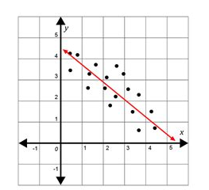
Line of best fit
Minimising the overall distance between our line and all of the existing data points
How do we express this mathematically?
Optimising the line of best fit

Slide 32
Line of best fit
We minimise the residuals (i.e. the total distance between all of the data points and the line of best fit
Cost = | y_{i} - y^ |

Slide 33
Line of best fit
Now that we have the cost of each data point (i.e. the distance of each datapoint from the line of best fit), how can we summarise the overall loss for all of the data points in one number?
How could we describe the overall distance for all of the data points?
Cost = | y_{i} - y^ |

Slide 34
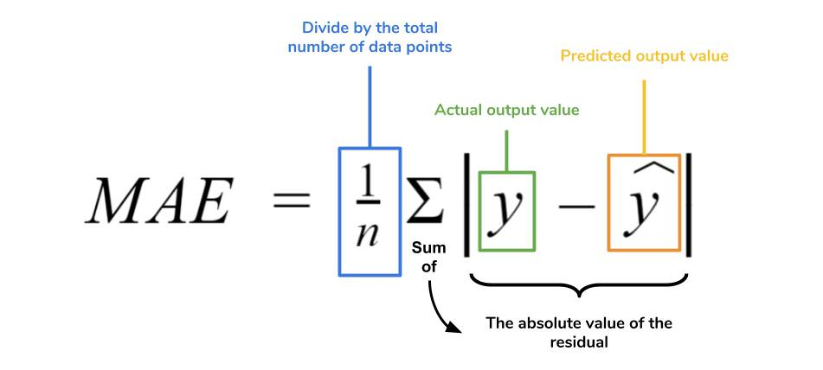
Line of best fit
The mean (average) of the loss values, known as the cost function
Mean absolute error
Cost = | y_{i} - y^ |

Slide 35
Calculating the loss From the data provided:
Draw these data points out as coordinates
Draw a line of best fit as best you can
Try to write an approximation of the line equation
Use 3) to output the predicted values for each income provided
Using the real and estimated probabilities calculate the cost for each data point
Use these to calculate the overall loss
Income (£k) | 10 | 20 | 30 | 40 | 50
Probability of paying loan interest this year | 22 | 42 | 69 | 93 | 85

Slide 36
Calculating the loss (2) From the data provided:
Draw these data points out as coordinates
Draw a line of best fit as best you can
Try to write an approximation of the line equation
Use 3) to output the predicted values for each x value provided
Using the real and estimated probabilities calculate the loss for each data point
Use these to calculate the overall cost
Years since roof repair | 1 | 3 | 5 | 10 | 20
Likelihood of roof needing significant repair | 8 | 30 | 40 | 65 | 78

Slide 37
Cost function - a great start
How can we increase the penalty for data points the further away they are?
Usually we want to ‘punish’ the line the further away it is from any given data point..

Slide 38
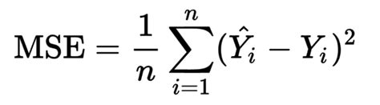
Mean squared error
We can square the costs, so that the larger the cost, the more it will increase by when squared.
Usually we want to ‘punish’ the line the further away it is from any given data point

Slide 39
Practise time
Number of years renting flat | 1 | 2 | 3 | 4 | 5
Number of yearly calls to the landlord | 20 | 8 | 7 | 4 | 1
Calculate the mean squared error for a given attempt at the line of best fit

Slide 40
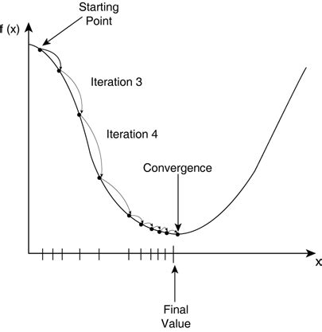
The aim of supervised machine learning
Loss
Minimise the cost - until convergence (i.e we find the smallest cost possible)
Otherwise known as gradient descent
Values of m

Slide 41


Code time
Create a machine learning model
Train it on our data
Output a line of best fit (y = mx + c)
Output a line of best fit (on a graph)
Output the cost value
Create predictions based on new x values that we provide
Using scikit learn to train a linear regression model

Slide 42
Theory revision time
How does linear regression work as a machine learning model?
Key words:
Coordinates
Y = mx + c
Gradient, coefficient, y-intercept
Line of best fit
Residuals, loss
Cost function
Mean squared error
Iterations, convergence
How does linear regression work as a machine learning model?

Slide 43

How does the ML model improve?
Reducing cost
Gradient descent is a common method in machine learning - finding the gradient for the cost values and following it down until finding the minimum

Slide 44
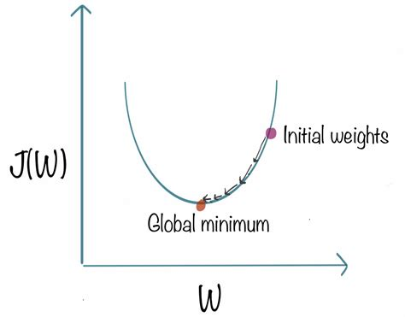
Important to remember
Your machine learning model will update its ‘parameters’ in order to minimise its cost function
Y = mx + c (m sometimes referred to as a weight (w))
“What values of m and c minimise our loss?”
MSE is just one option for a cost function.
Gradient descent is just one option for a cost optimisation strategy, but a very good way to visualise cost function strategies.

Slide 45
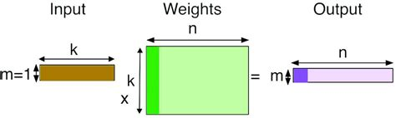
How does machine learning do the maths?
Matrix operations
Multiplying all of the data points (x_{i}) with the different values of m and c

Slide 46
N-dimensional data types in machine learning
Scalar - a single number
Vector - A one-column collection of scalars
Matrix - An n-column collection of vectors
Simplified terms for now

Slide 47
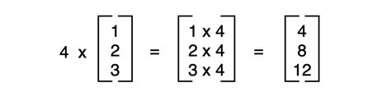
Scalar
A single number

Slide 48
Vector
A one-column collection of scalars

Slide 49
Matrix
An n-column collection of vectors

Slide 50
Notation to be aware of
A - reference to matrix A. We use upper case to denote matrices and vectors, lowercase for scalars
a_{i,j} - A single value in row i, column j
A . B - we use a dot to represent multiplication between two matrices (and/or a vector)
A^{T} - The transpose of a matrix (rows swapped with columns)
A⁻¹ - The inverse of a matrix (you won’t need to know about this, just to recognise it for now)
| x | - The absolute value of a given value. Turns negative numbers positive, e.g. -5 --> 5
Scalars, vectors, matrices

Slide 51
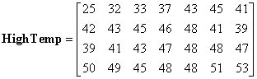
Notation revision
a_{i,j}
What are the values i and j for 25?
Which value is at a_{3,4}?
What are the values of i and j at the bottom right value (53)
Which value is at a_{2,6}?
Test time: rows and columns

Slide 52
Matrix operations
Scalar-matrix multiplication
Matrix-matrix addition
Matrix-matrix multiplication
Describe each of the following based on the definitions that we’ve gone over so far

Slide 53
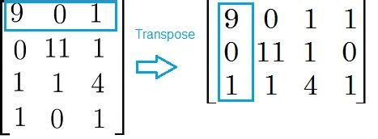
Transposing matrices
The first row becomes the first column (a_{i,j} becomes a_{j,i})
This idea becomes useful in matrix multiplication
How does the shape of a matrix change when it’s transposed?

Slide 54
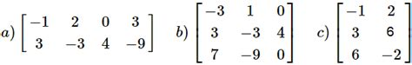
Transposing matrices
Write out the transpose of each of the following matrices, including the change in shape (rows, columns)

Slide 55
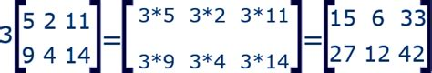
Scalar-matrix multiplication
Straightforward - multiply the scalar by all of the values in a vector or matrix.
The resultant shape doesn’t change.

Slide 56
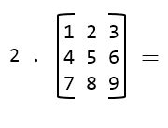
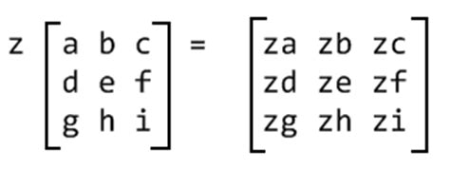

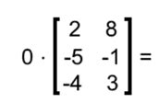
Scalar-matrix multiplication
1)
2)
3)
4)
Carry out the following scalar-matrix multiplications

Slide 57
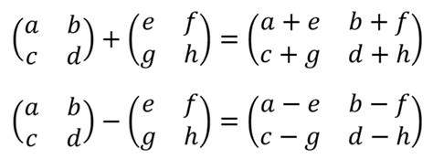
Matrix addition and subtraction
Matrices must be the same shape
The resultant shape is the same
a_{i,j} + b_{i,j} = c_{i,j}

Slide 58
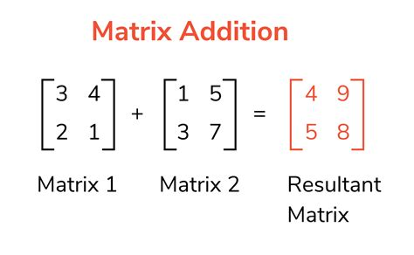
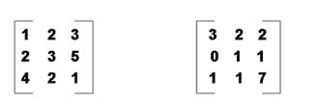
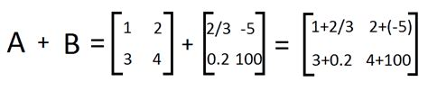
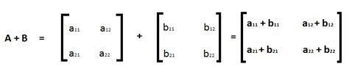
Matrix-matrix addition
1)
2)
3)
4)
Carry out the following matrix-matrix additions

Slide 59
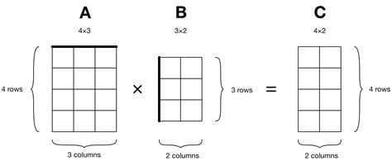
Dot products
Multiplying two matrices is less straightforward

Slide 60
Dot products rules - matrix shapes
A_{j} must be the same as B_{i}. The resultant matrix will be shape A_{i} , B_{j}
Try writing this down on paper for yourself

Slide 61
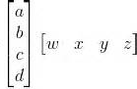
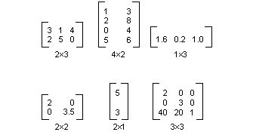
Dot products
1)
2)
3)
4)
Which of the following matrix multiplications would work?
For those that work what will be the resultant

Slide 62
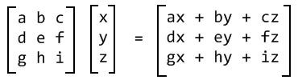
Dot products
First in top row x top of vector + second in row x second down in vector + third in row x third in vector …
Repeat for each row in the matrix
Have a think as to why this wouldn’t work if the dimensions didn’t work as per the rules discussed earlier.

Slide 63
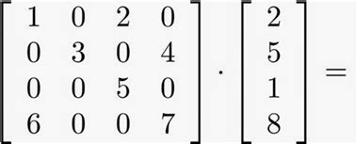
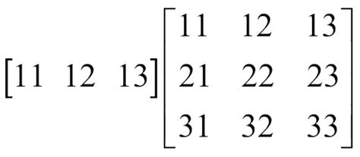
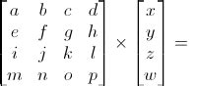
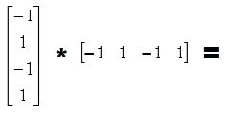
Dot products
1)
2)
3)
4)
Practise makes perfect (and more sense!)

Slide 64
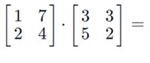
Dot products - two matrices
The same process, each column is separate.

Slide 65
Dot products - not commutative
A . B != B . A

Slide 66
Dot products - not commutative
Calculate A . B and B . A. Are the results different?

Slide 67
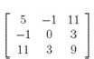
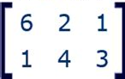
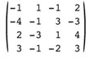
Revising matrix operations
Write out the transpose of each of the following matrices, including the change in shape (rows, columns)

Slide 68
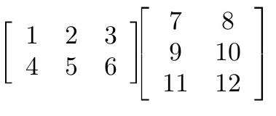
Revising matrix operations
Write out the products of the following

Slide 69
Revising matrix operations
Consider the shapes and the order of the matrices.
What are the rules involved in matrix multiplications?

Slide 70

Try it for yourself
Matrix operations with numpy
Scalar-matrix multiplications
Matrix-matrix addition
Matrix-matrix multiplication

Slide 71
In review
Machine learning fundamentals:
Introduction to regression and classification
Matrix operations
Linear regression
Coding our first ML models
Linear regression

Slide 72
Next lesson
Linear regression review
Train test split
Logistic regression
Introduction to performance metrics - accuracy

